Slide 1


A Comprehensive Analysis and Forecast of Bike Sharing Programs
PRESENTED BY:-
^{SENIR LOVEDALE}
^{ASHUTOSH PATIL}
^{ROSHNI DESHMUKH}
^{PRATHMESH JADHAV}
^{DEVANSHU BHAT}

Slide 2


Introduction
Bike Sharing Programs are revolutionizing urban transportation. This presentation provides a comprehensive analysis and forecast of the industry. We will examine key trends, challenges, and opportunities in the market.

Slide 3

Key Trends
A US bike-sharing provider BoomBikes has recently suffered considerable dips in their revenues due to the ongoing Corona pandemic. The company is finding it very difficult to sustain in the current market scenario. So, it has decided to come up with a mindful business plan to be able to accelerate its revenue as soon as the ongoing lockdown comes to an end, and the economy restores to a healthy state..

Slide 4
Problem Statement
:~Which variables are significant in predicting the demand for shared bikes.
:~How well those variables describe the bike demands

Slide 5
About Dataset
instant: record index
dteday : date
season : season (1:spring, 2:summer, 3:fall, 4:winter)
yr : year (0: 2018, 1:2019)
mnth : month ( 1 to 12)
holiday : weather day is holiday or not
weekday : day of the week
workingday : if day is neither weekend nor holiday is 1, otherwise is 0.
weathersit : - 1: Clear, Few clouds, Partly cloudy, Partly cloudy - 2: Mist + Cloudy, Mist + Broken clouds, Mist + Few clouds, Mist - 3: Light Snow, Light Rain + Thunderstorm + Scattered clouds, Light Rain + Scattered clouds - 4: Heavy Rain + Ice Pallets + Thunderstorm + Mist, Snow + Fog
temp : Normalized temperature in Celsius. The values are divided to 41 (max)
atemp: Normalized feeling temperature in Celsius. The values are divided to 50 (max)
hum: Normalized humidity. The values are divided to 100 (max)
windspeed: Normalized wind speed. The values are divided to 67 (max)
casual: count of casual users
registered: count of registered users
cnt: count of total rental bikes including both casual and registered

Slide 6
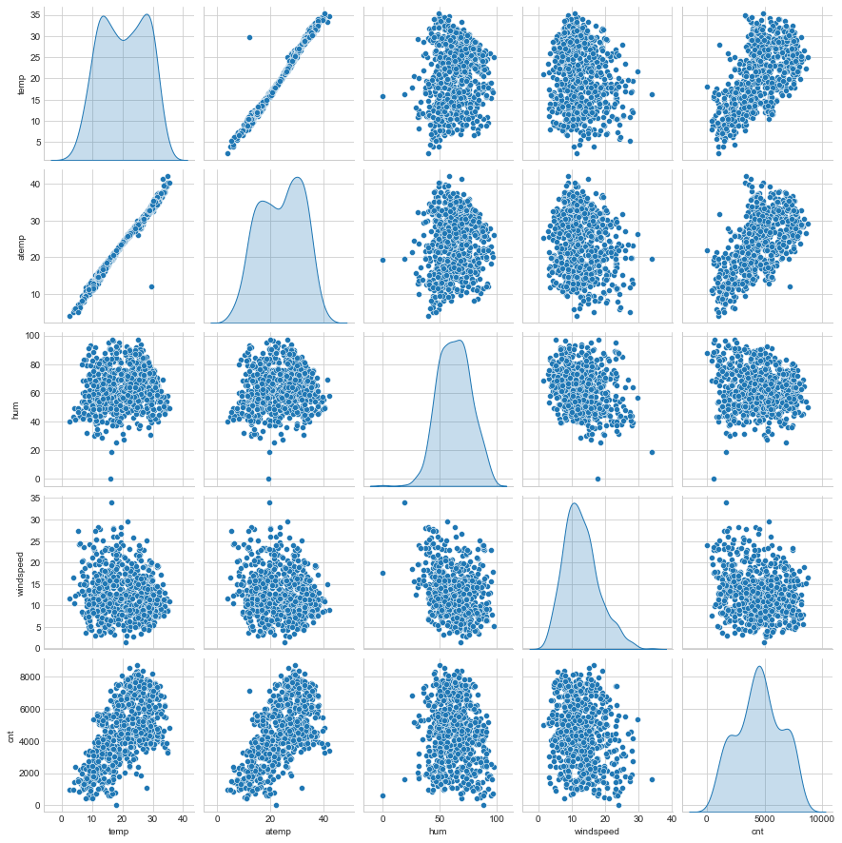
Exploratory Data Analysis (EDA)
Observation - From the above pair plot it can be clearly observed that there exists a linear relationship between temp, atemp, and cnt.
It is evident that we have two similar fields :
temp : temperature in Celsius
atemp: feeling temperature in Celsius
We can check if there exists a positive correlation between them

Slide 7
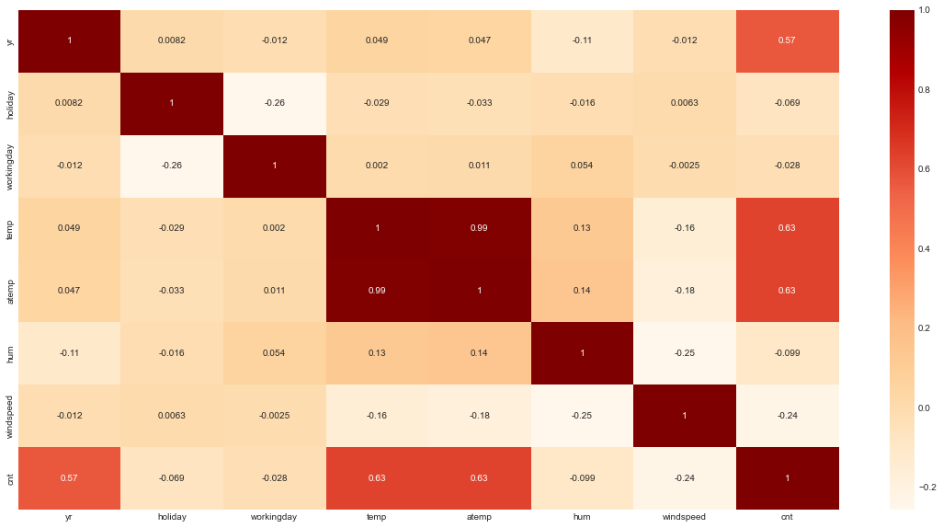
Chacking Correlation
As suspected, there is 99% correlation between temp and atemp.We can hence drop one of these later while building our model.

Slide 8
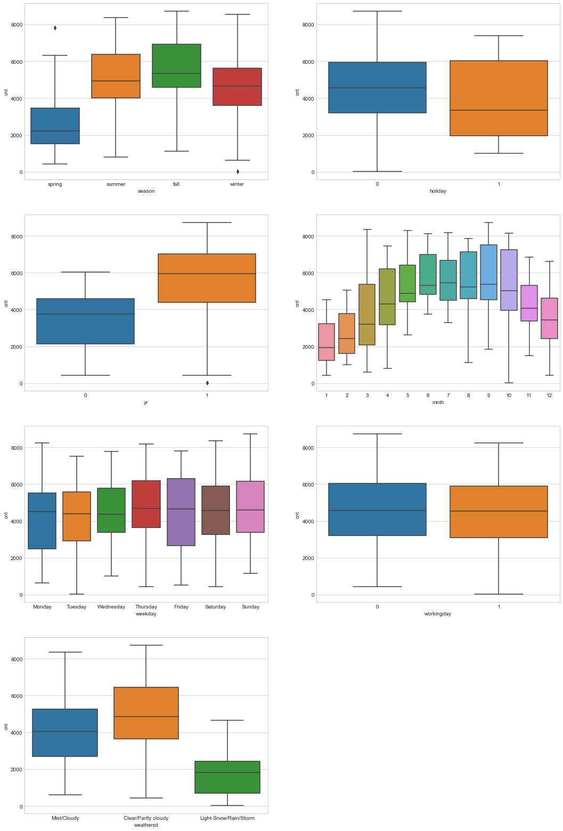
Observation
season : One-third (more than 30%) of the bookings were done in fall season and the median lies around 5000, followed by Summer and Winter. Clealry this can serve as a good predictor for our analysis.
holiday : Majority(~ 97%) of the booking took place whne it wasn't a holiday. We have a very high bias here and thus it maynot be a good predctor variable.
yr : During yr 1 , we have more number of bookings (almost twice) than yr 0. Since our analysis will be based only on two years (2018 and 2019), they are important predictors.
mnth : Distribution of months looks like a normally distributed, with months : 5-9 leading in number of bbokings and crossing the median over around 4500-5000. This indeed can serve as a good predictor.
weekday : No clear pattern observed here as all the days show a similar spread This maynot be able to serve as a good predictor
workingday : We have a high booking count on working day (i.e 1)and a median value close to 5000. It may serve as a good predictor
weathersit : Majority of the bookings took place during a clear/partly cloudy weather with a median at around 5000 followed by misty/cloudy weather, with median 4000. This can also serve as a good predictor.

Slide 9
Model Building
*In model building we are using
*And pick the model with best R2 score
we are using the following model's
1) Linear Regression
2)Ridge Regression
3)Lasso Regression
4)Decision Tree
5)Random Forest

Slide 10
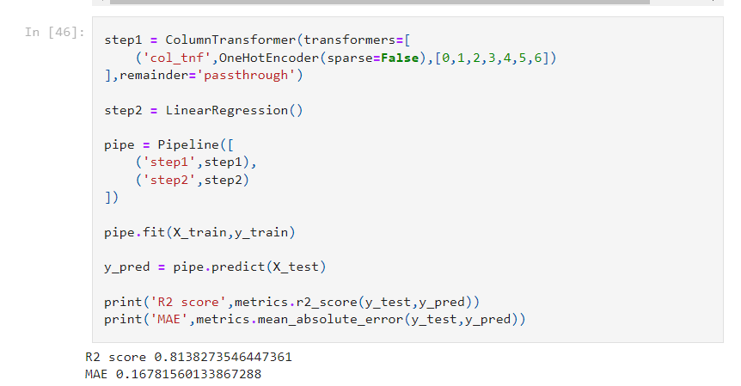
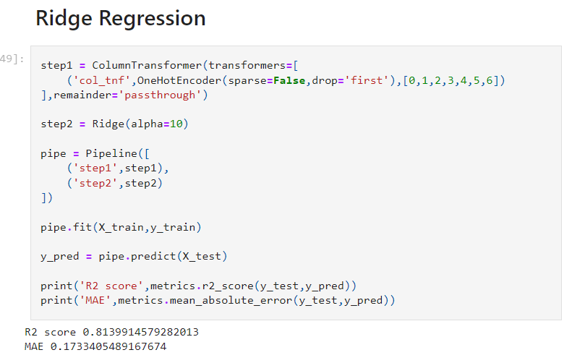
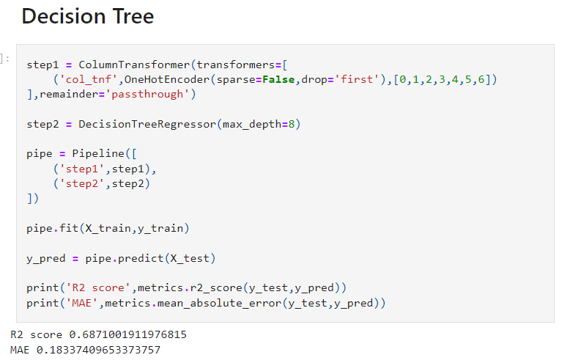
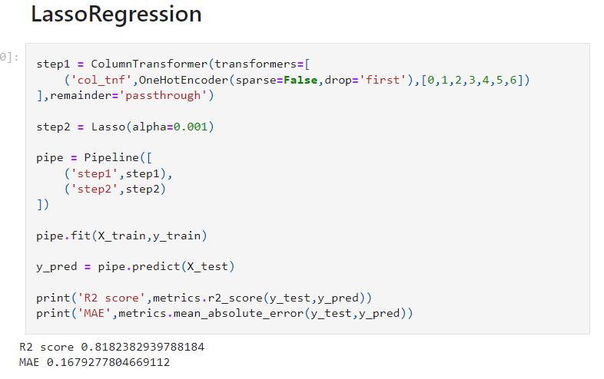

Slide 11
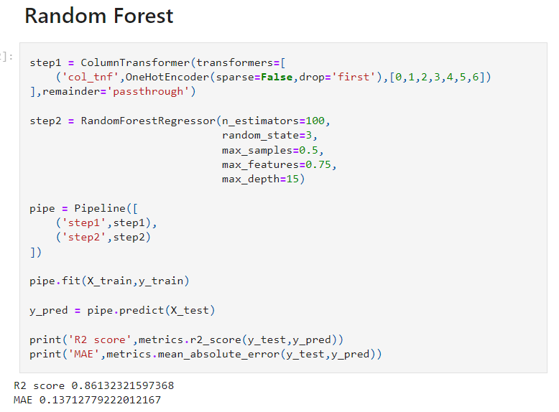
So we can see random forest has best r2 score
So we are taking Random Forest for building model

Slide 12
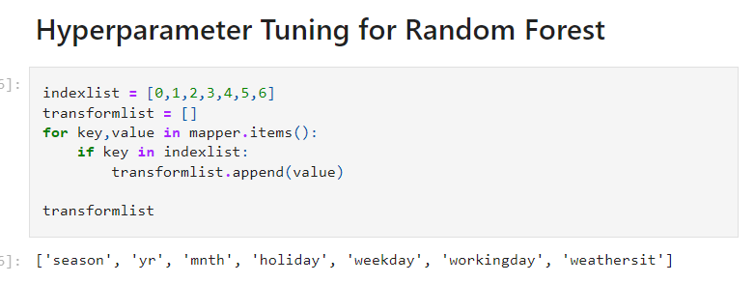
Hyperparameter Tuning

Slide 13
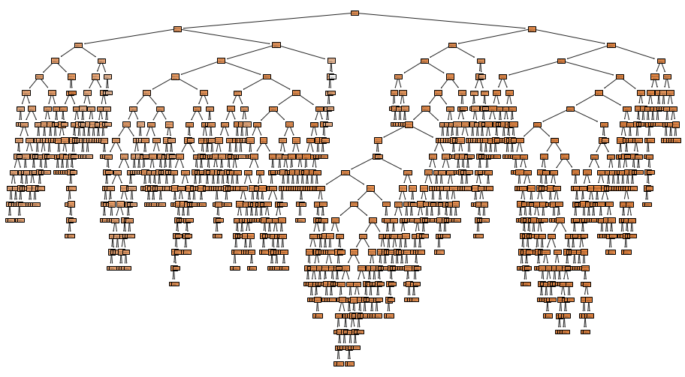
Ploting Random forest

Slide 14
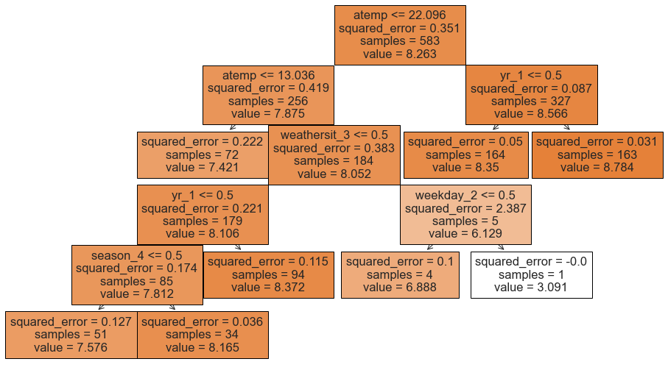
After pruning

Slide 15
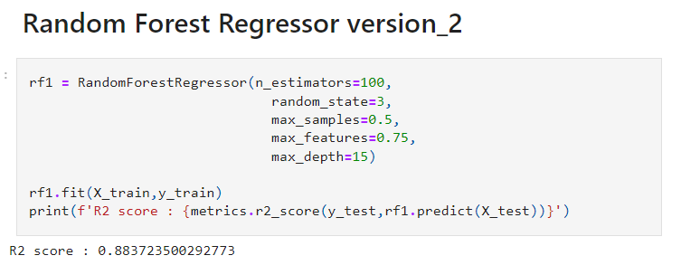
After using Hyperparameter Tuning
Our R2 score is 88%

Slide 16
Conclusion
Based on the provided code, it appears that you are training an XGBoost regression model to predict the 'cnt' variable. After performing grid search cross-validation and fitting the model, you are evaluating its performance on the validation set. The model's performance metrics on the validation set are as follows: - Mean Absolute Error (MAE): 399.845 - Mean Squared Error (MSE): 342169.432 - R-squared (R2): 0.901 Afterward, you create a pipeline with the XGBoost regressor and fit it on the training set. You then use this pipeline to predict the 'cnt' variable on the test set. The performance metrics on the test set are: - R-squared (R2) score: 0.883 - Mean Absolute Error (MAE): 530.279 Finally, you visualize the distribution of the actual 'cnt' values (in orange) and the predicted 'cnt' values (in blue) using a seaborn distplot. Based on the provided information, the conclusion is that the XGBoost regression model performs reasonably well, with an R2 score of approximately 0.901 on the validation set and 0.883 on the test set. The MAE values indicate that, on average, the model's predictions have an absolute difference of around 399.845 on the validation set and 530.279 on the test set. The visualization allows you to compare the distribution of the actual and predicted 'cnt' values.

Slide 17
Thanks
you

